Slide 1



Slide 2


OCT 2018
FROM NLP TO DEEP NLP WITH TENSORFLOW

Slide 3


Slide 4
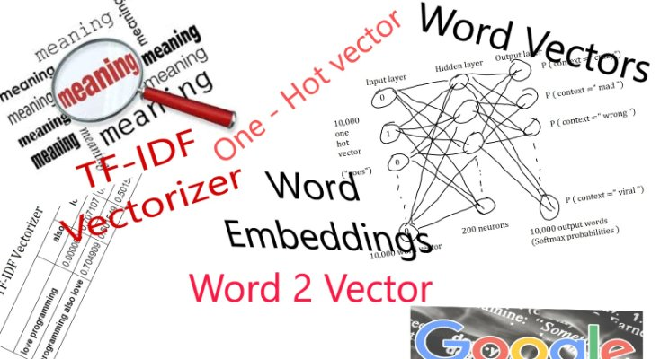

Slide 5
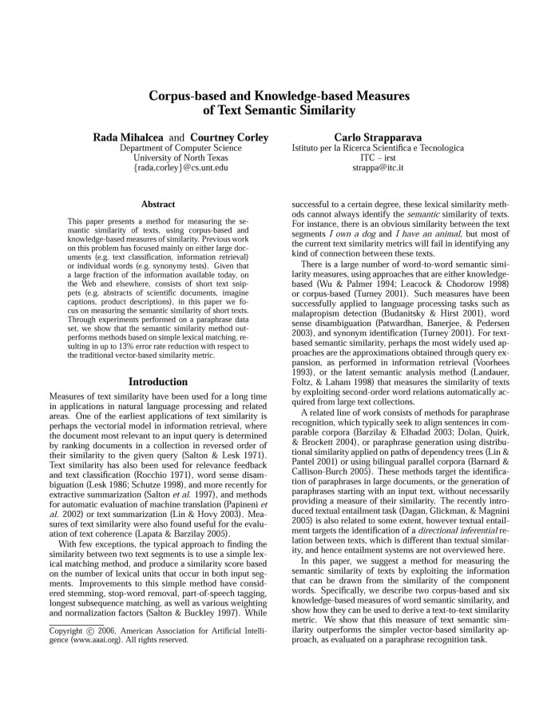
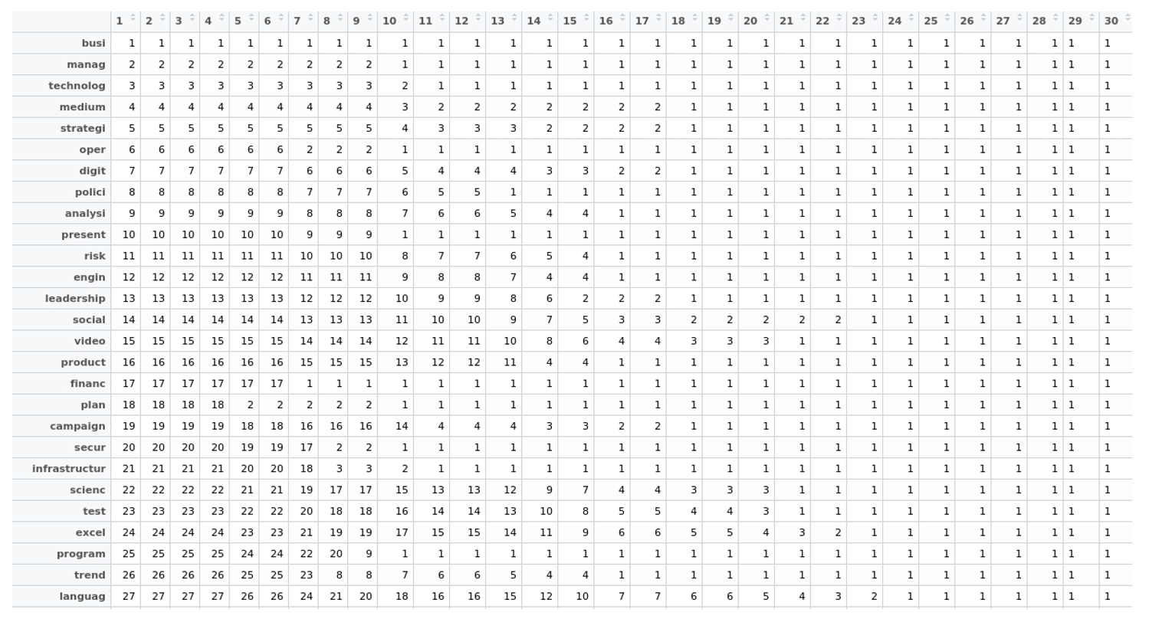
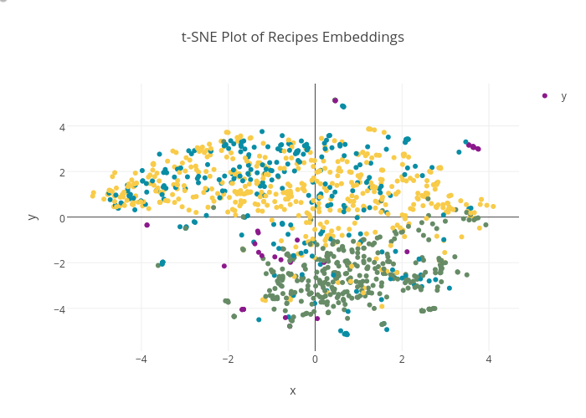

Slide 6



Agenda
Status
1. What does NLP mean?
2. From text to numbers
3. Embeddings
4. A simple semantic validator: analogies
5. Deep Learning in NLP
6. Tensorflow
Globant Proprietary | Confidential Information

Slide 7
Agenda
Status
Natural Language Processing
...
Aims computers to fully understand our human language in order to perform a useful task.
A perfect language understanding is AI-Complete
1. What does NLP mean?
2. From text to numbers
3. Embeddings
4. A simple semantic validator: analogies
Statistics
Linguistics
5. Deep Learning in NLP
6. Tensorflow
Computer Science
NLP
Globant Proprietary | Confidential Information

Slide 8
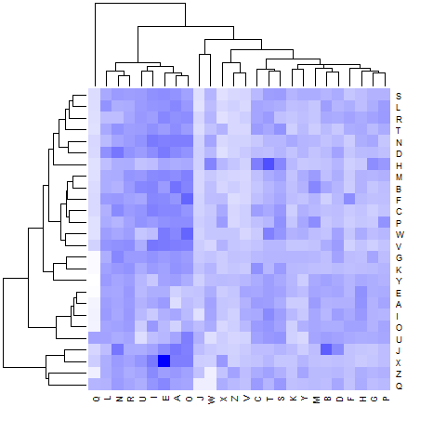
What does NLP mean?
Natural Language Processing
Useful tasks:
Question answering
Spell checking
Translations
Chatbots
The most basic form in which a machine can understand is with numbers. NLP has a challenging task to transform text to a suitable and numerical representation that any machine learning algorithm can use.
Globant Proprietary | Confidential Information

Slide 9

Agenda
Status
Text comprehension
Done
Machines only understand numbers. We need to transform inputs into a numerical representation. To do so, we need to count.
1. What does NLP mean?
2. From text to numbers
3. Embeddings
4. A simple semantic validator: analogies
5. Deep Learning in NLP
6. Tensorflow
Globant Proprietary | Confidential Information

Slide 10
The University of Szeged (, ) is a large research university in Hungary. It is located in Hungary's third-largest city, Szeged, in Csongrád County in the Southern Great Plain. The University is one of Hungary's most important universities and is among the most prominent higher education institutions in Central Europe. According to the "Academic Ranking of World Universities" by Shanghai Jiao Tong University (2003, 2004, 2005), it was ranked 203rd–300th in the complete list (in a tie), 80th–123rd in the scientific ranking of European universities, and first in the Hungarian national ranking. In 2013 it was ranked 401-500 in the world, 124th–168th in the scientific ranking of European universities, and second in the national ranking. In 2014, the QS World University Rankings put the University of Szeged as 501-550 among universities globally. Its highest ranked subject area was Modern Languages with 101-150 globally. The University's operating budget for 2014 was US$220 million.

Slide 11


How to transform text to numbers
Main goal of NLP is getting a Language Model...
Probability(TEXT)

Slide 12
How to transform text to numbers
Main goal of NLP is getting a Language Model...
P(John likes to watch movies) =
P(games | John likes to watch movies) * P(movies | John likes to watch) * P(watch | John likes to) * P(to | John likes) * P(likes | John) P(John)
P(word) = count(word) / length corpus

Slide 13
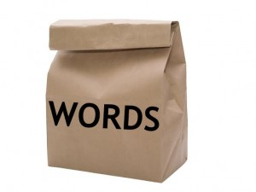

How to transform text to numbers
John likes to watch movies. Mary likes movies too. John also likes to watch football games.
John | likes | to | watch | movies | . | Mary | likes | movies | too | . | John | also | likes | to | watch | football | games | .
John | 1
John | 1
likes | 1
to | 1
watch | 1
John | 1
likes | 2
to | 1
watch | 1
movies | 1
. | 1
Mary | 1
John | 1
likes | 2
to | 1
watch | 1
movies | 2
. | 2
Mary | 1
too | 1
John | 2
likes | 3
to | 1
watch | 1
movies | 2
. | 2
Mary | 1
too | 1
also | 1
John | 2
likes | 3
to | 2
watch | 2
movies | 2
. | 3
Mary | 1
too | 1
also | 1
football | 1
games | 1

Slide 14
How to transform text to numbers
<Vocabulary>
<N-gram>

Slide 15
How to transform text to numbers: a bigram model
John likes to watch movies. Mary likes movies too. John also likes to watch football games.
John | likes | to | watch | movies | Mary | likes | movies | too | John | also | likes | to | watch | football | games
John likes | 1
likes to | 1
to watch | 1
John likes | 1
likes to | 1
to watch | 1
watch movies | 1
movies Mary | 1
Mary likes | 1
John likes | 1
likes to | 1
to watch | 2
watch movies | 1
movies Mary | 1
Mary likes | 1
...
football games | 1

Slide 16
How to transform text to numbers: Vocabulary
Vocabulary
 | John | likes | to | watch | movies | Mary | too | also | football | games
John | 0 | 2 | 1 | 1 | 0 | 0 | 0 | 0 | 0 | 0
likes |  | 0 | 1 | 1 | 0 | 0 | 0 | 0 | 0 | 0
to |  |  | 0 | 1 | 0 | 0 | 0 | 0 | 0 | 0
watch |  |  |  | 0 | 1 | 2 | 0 | 1 | 1 | 1
movies |  |  |  |  | 0 | 2 | 0 | 1 | 1 | 1
Mary |  |  |  |  |  | 0
too |  |  |  |  |  |  | 0
also |  |  |  |  |  |  |  | 0
football |  |  |  |  |  |  |  |  | 0
games |  |  |  |  |  |  |  |  |  | 0
Vocabulary

Slide 17

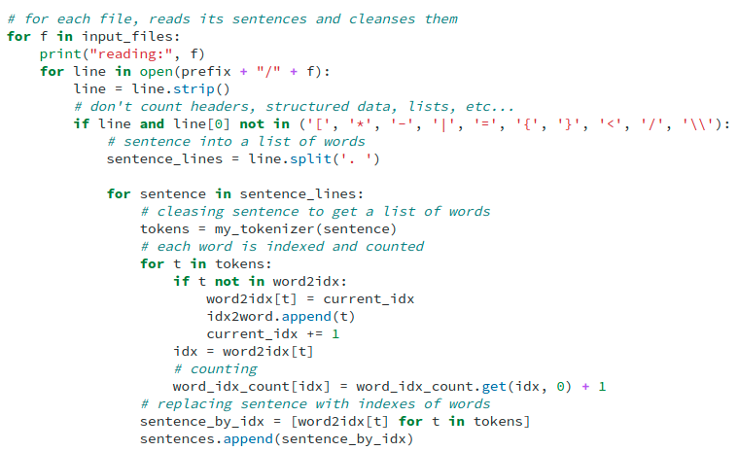
Challenge: Bigram model.
Make a bigram model. That is, create a function in which you make a count of contiguous pair of words in each sentence. See the function get_wikipedia_data(n_files).
Notes:
you can use a matrix or a dictionary in python for itse

Slide 18
Text to numbers: some preprocessing steps
Cleansing your text out of unnecessary characters (e.g. punctuation)
Subsampling. Use a sample of the vocabulary but representative.
https://github.com/Okenfor/from_NLP_to_Deep_NLP

Slide 19
Agenda
Status
Embeddings
Done
Large set of features in any dataset has always been a headache for any machine learning algorithm until these days.
Does curse of dimensionality sound familiar?
1. What does NLP mean?
Done
2. From text to numbers
3. Embeddings
4. A simple semantic validator: analogies
5. Deep Learning in NLP
6. Tensorflow
Globant Proprietary | Confidential Information

Slide 20

Embed to make more efficient your task
How to reduce your vocabulary but without losing their value?
Feature reduction is a task that seeks how to reduce a dataset without losing the meaning.
The most common techniques:
PCA (Principal Component Analysis)
tSNE (t-Distributed Stochastic Neighbor Embedding)
SVD (Singular Value Decomposition)

Slide 21
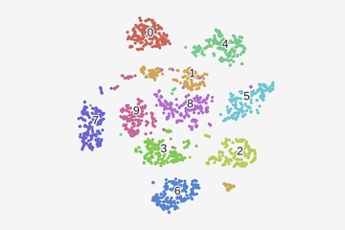

Absorb most variance or discover groups of features
http://setosa.io/ev/principal-component-analysis/
https://www.youtube.com/watch?v=NEaUSP4YerM
<< Both have a parameter for the number of components. >>

Slide 22
Agenda
Status
How suitable is an embedding in NLP?
Done
1. What does NLP mean?
Done
2. From text to numbers
Linguistics to the rescue...
Done
3. Embeddings
4. A simple semantic validator: analogies
5. Deep Learning in NLP
6. Tensorflow
Globant Proprietary | Confidential Information

Slide 23
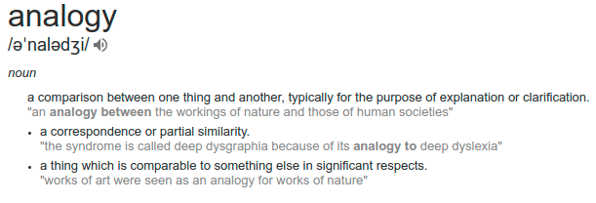

Analogies
Heading H2
In NLP, word embeddings means to discover groups of words with higher similarity inner them. Meaning clustering.

Slide 24
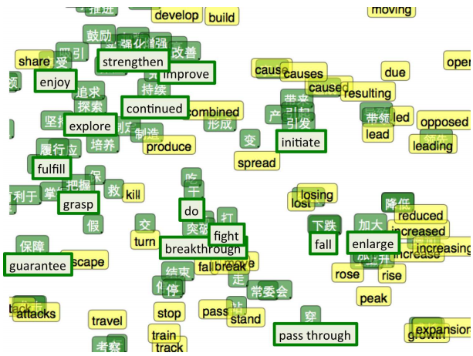
Analogies
t-SNE visualization of the bilingual word embedding. Green is Chinese, Yellow is English.
Zou, W. Y., Socher, R., Cer, D., & Manning, C. D. (2013). Bilingual word embeddings for phrase-based machine translation. In Proceedings of the 2013 Conference on Empirical Methods in Natural Language Processing (pp. 1393-1398).
http://ai.stanford.edu/~wzou/emnlp2013_ZouSocherCerManning.pdf

Slide 25
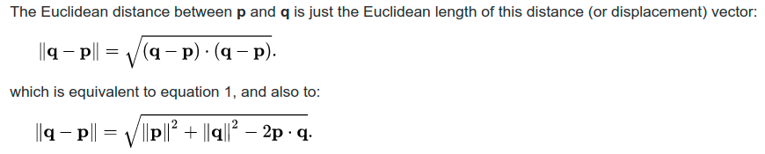
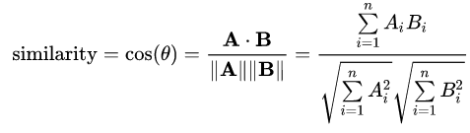
But, a distance function is needed.
Euclidean (Cartesian)
Cosine (Angular)
Distance = 1 - Similarity

Slide 26
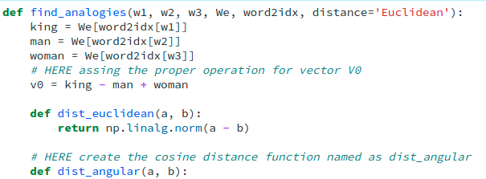
Challenge: Angular analogies.
Complete the function find_analogies implementing the cosine distance.
Notes:
you can use a matrix or a dictionary in python for itse

Slide 27

Agenda
Status
Deep learning vs Machine learning
Done
1. What does NLP mean?
Done
2. From text to numbers
Done
3. Embeddings
Done
4. A simple semantic validator: analogies
5. Deep Learning in NLP
6. TensorFlow
Globant Proprietary | Confidential Information

Slide 28
Embeddings ...
a baby step in Deep Learning but a giant leap towards Natural Language Processing

Slide 29

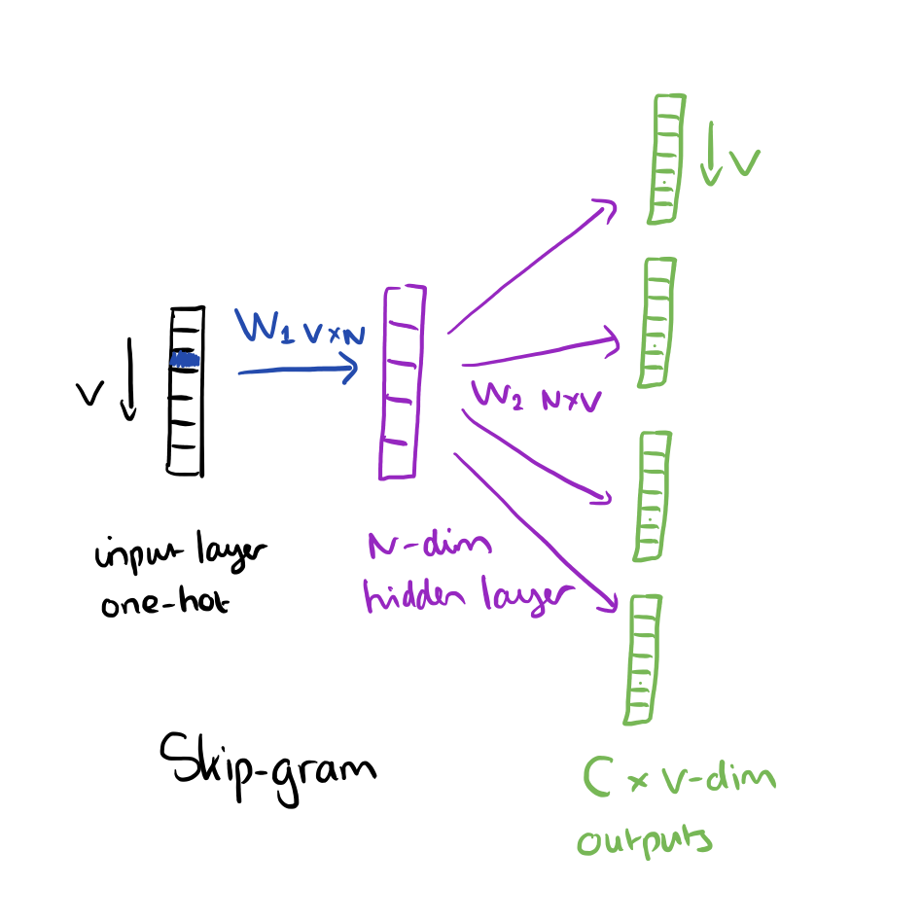
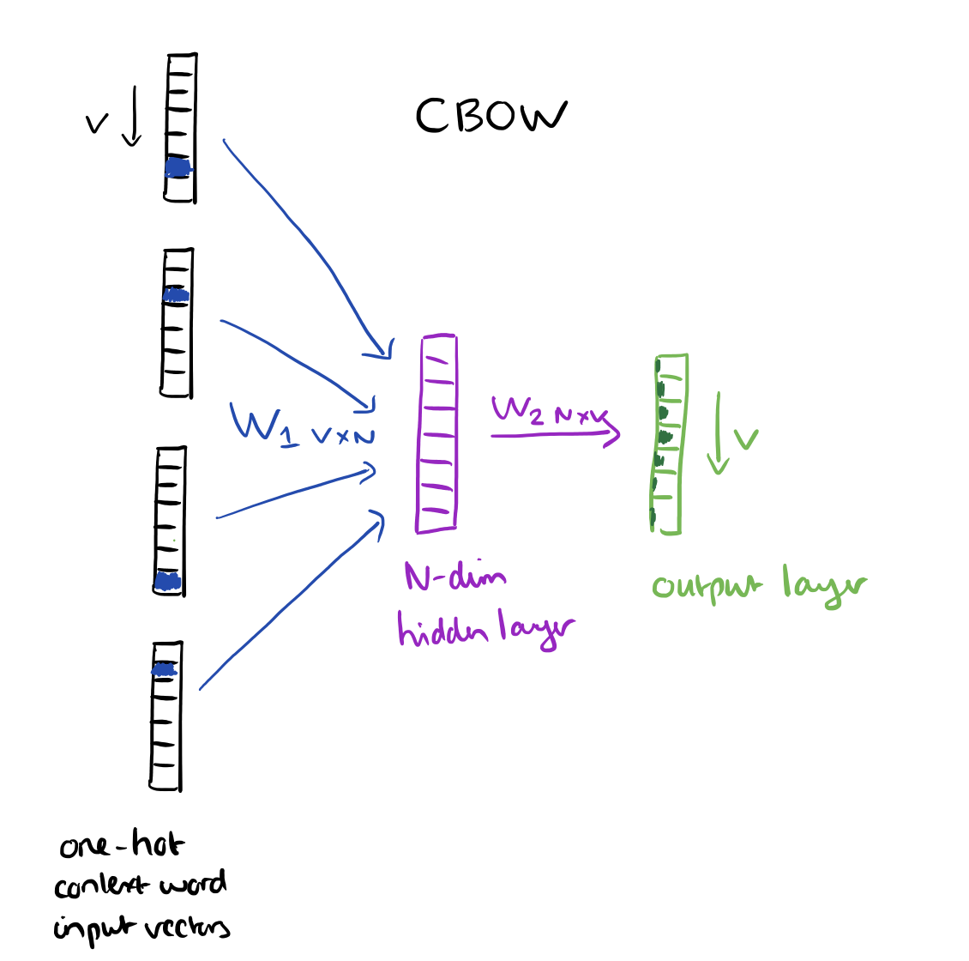
Feature extraction in NLP with DL
Word2Vec (Mikolov)
Using a simple neural network: one hidden layer and linear units and a softmax output layer, calculates embeddings as hidden weights.
There are two architectures:
Mikolov, Tomas; Sutskever, Ilya; Chen, Kai; Corrado, Greg S.; Dean, Jeff (2013). Distributed representations of words and phrases and their compositionality. Advances in Neural Information Processing Systems. arXiv:1310.4546
Mikolov, Tomas; et al. "Efficient Estimation of Word Representations in Vector Space". arXiv:1301.3781

Slide 30
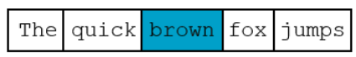
The idea of context works!
The
hidden
The
hidden
quick
quick
brown
brown
fox
fox
jumps
jumps
CBOW
SkipGram

Slide 31
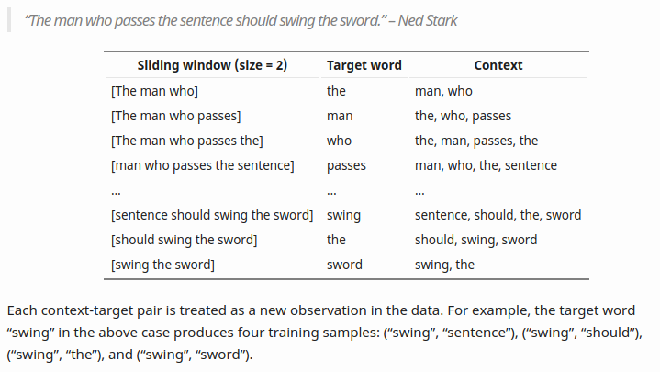
Feature extraction in NLP with DL
https://lilianweng.github.io/lil-log/2017/10/15/learning-word-embedding.html#count-based-vector-space-model

Slide 32
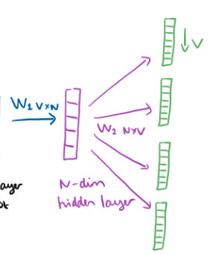
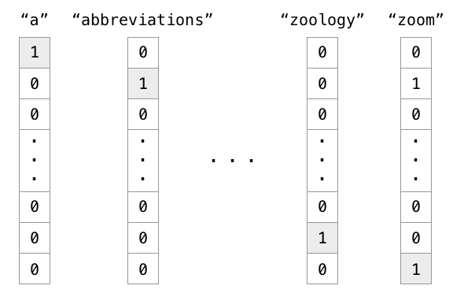
Word2Vec features
One hot vector representation of words

Slide 33
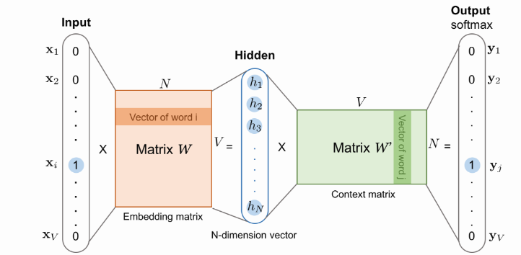
Word2Vec NN architecture

Slide 34
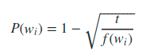
Challenge: Applying probability formula for subsampling.
Subsampling
Calculate relative frequencies of words, i.e. count / total_words.
Estimate probabilities using the formula above. Remember, threshold t is a function parameter.
Filter words in which its probability is less than a uniformly distributed random number.
Notes:
you can use a matrix or a dictionary in python for itse

Slide 35

Word2Vec: The fake task!
Negative Sampling
Only positive cases!
Subsampling some words out of the context in order to enhance the quality of embeddings.

Slide 36
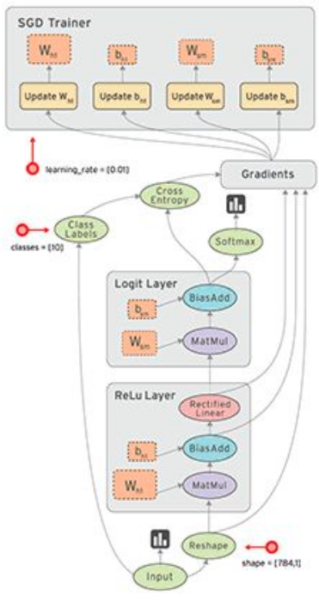
Agenda
Status
Tensors = Vectors
Done
1. What does NLP mean?
Tensorflow is a framework for implementing different neural networks types in a high scale processing architecture. i.e. CPUs, GPUs, TPUs.
Uses data flow graphs: neural network training and evaluation can be represented as data flow graphs.
Done
2. From text to numbers
Done
3. Embeddings
Done
4. A simple semantic validator: analogies
Done
5. Deep Learning in NLP
6. TensorFlow
Globant Proprietary | Confidential Information

Slide 37
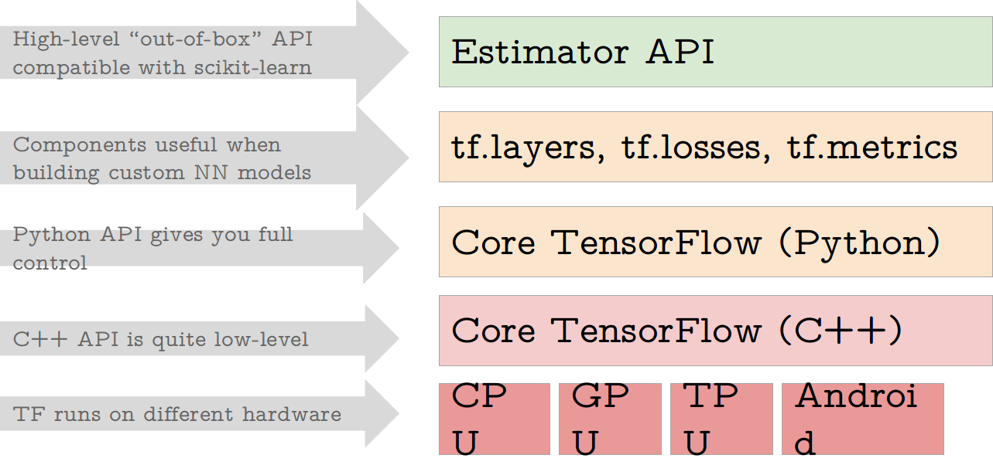
TensorFlow toolkit hierarchy

Slide 38
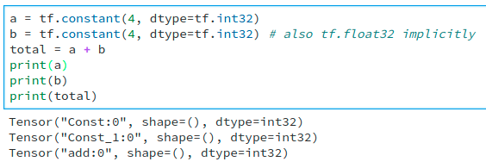
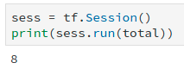
TF is lazy...
A graph
Tensors
a
b
add
Operations
c
A session

Slide 39
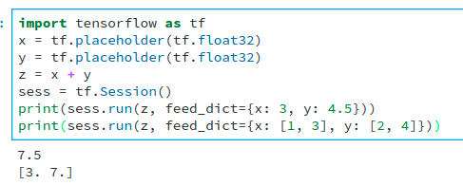
TF placeholder allows dynamic input, like streaming

Slide 40

Word2Vec input format in tensorflow

Slide 41
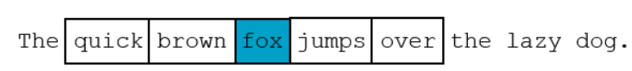
Challenge: Last but not least.
Getting the target properly
v
v
window
window
idx
words
Notes:
you can use a matrix or a dictionary in python for itse

Slide 42
TensorFlow HUB
import tensorflow as tf
import tensorflow_hub as hub
with tf.Graph().as_default():
embed = hub.Module("https://tfhub.dev/google/nnlm-en-dim128-with-normalization/1")
embeddings = embed(["A long sentence.", "single-word", "http://example.com"])
with tf.Session() as sess:
sess.run(tf.global_variables_initializer())
sess.run(tf.tables_initializer())
print(sess.run(embeddings))

Slide 43

Questions?

Slide 44


Thank You
Notes:
http://bit.ly/GLOBANT

